Slide 1
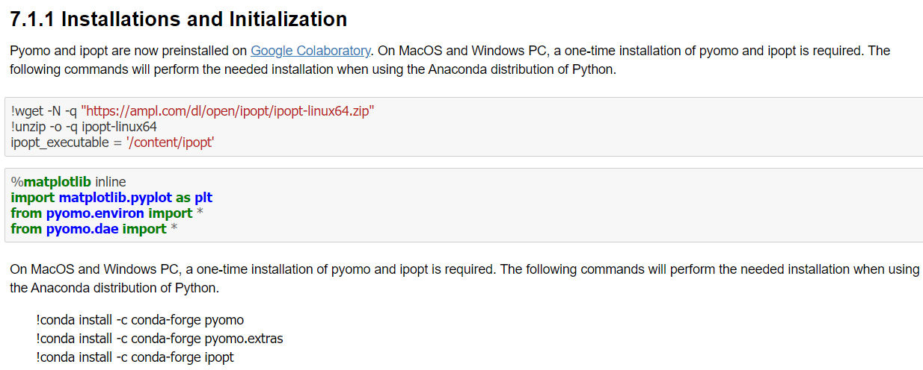
Simulation and Optimal Control: Simulation and Optimal Control in Pharmacokinetics

Slide 2
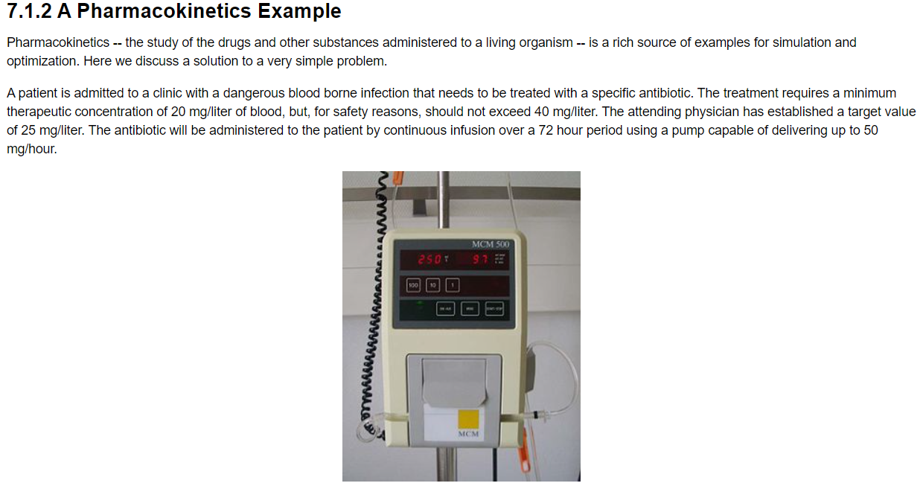
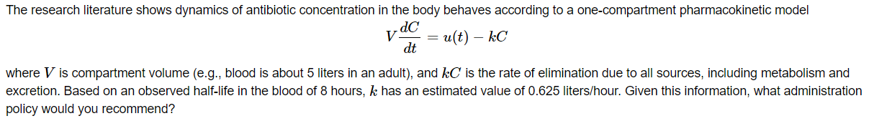
Simulation and Optimal Control: Simulation and Optimal Control in Pharmacokinetics

Slide 3
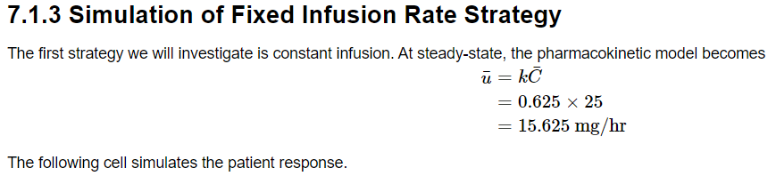
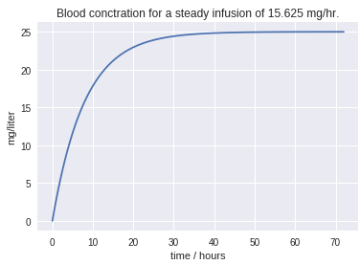
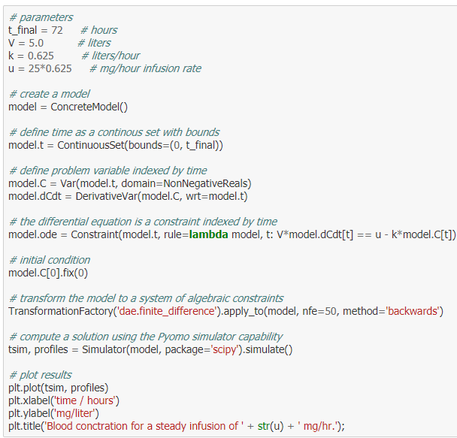
Simulation and Optimal Control: Simulation and Optimal Control in Pharmacokinetics

Slide 4
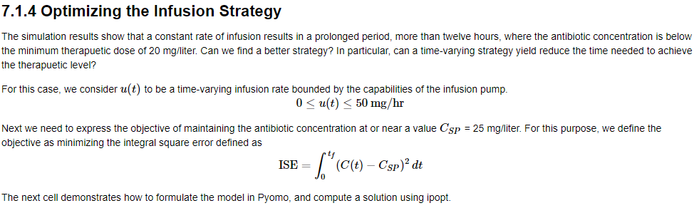
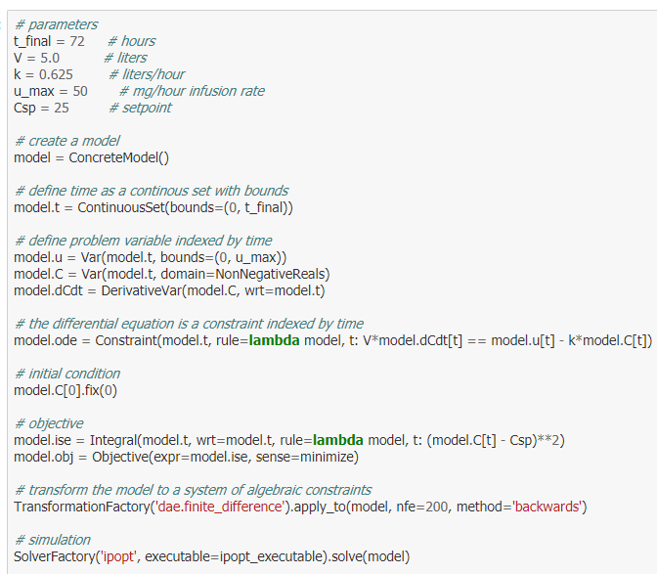
Simulation and Optimal Control: Simulation and Optimal Control in Pharmacokinetics

Slide 5
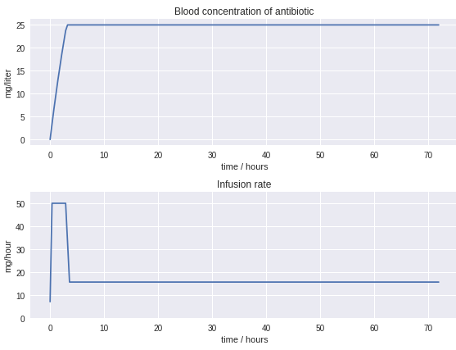
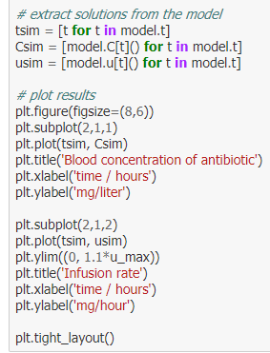
Simulation and Optimal Control: Simulation and Optimal Control in Pharmacokinetics

Slide 6
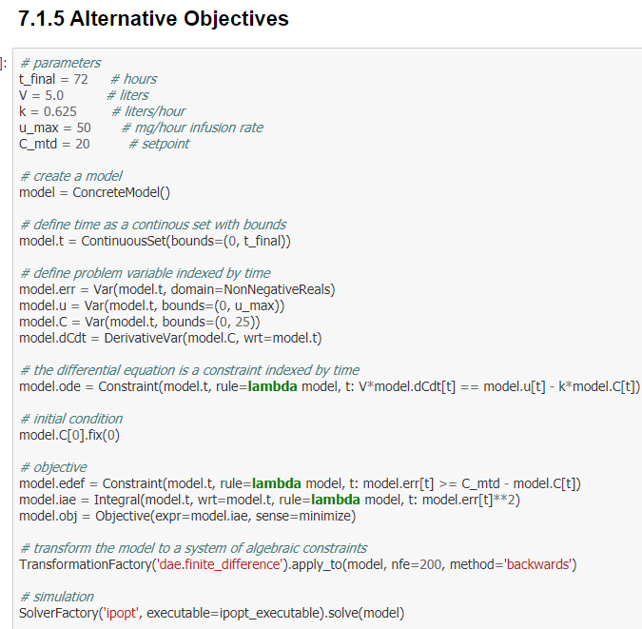
Simulation and Optimal Control: Simulation and Optimal Control in Pharmacokinetics

Slide 7
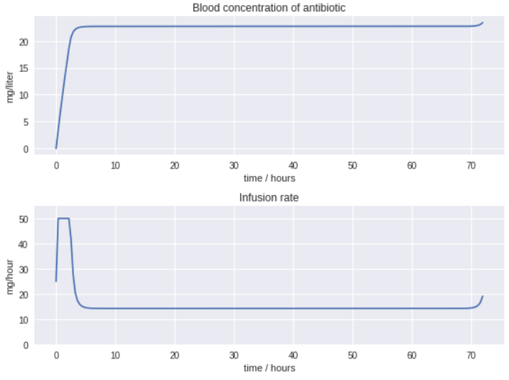
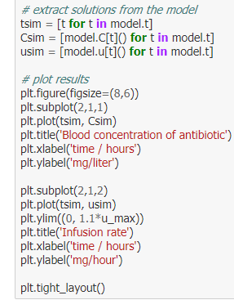
Simulation and Optimal Control: Simulation and Optimal Control in Pharmacokinetics

Slide 8
Simulation and Optimal Control: Simulation and Optimal Control in Pharmacokinetics

Slide 9
Simulation and Optimal Control: Simulation and Optimal Control in Pharmacokinetics

Slide 10
Simulation and Optimal Control: Simulation and Optimal Control in Pharmacokinetics

Slide 11
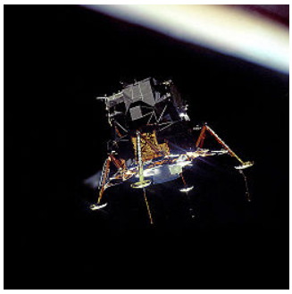
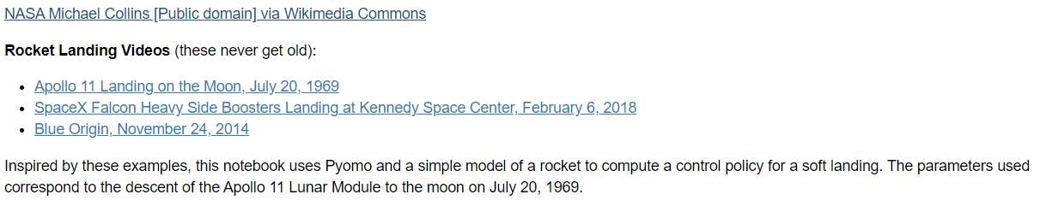
Simulation and Optimal Control: Soft Landing a Rocket

Slide 12
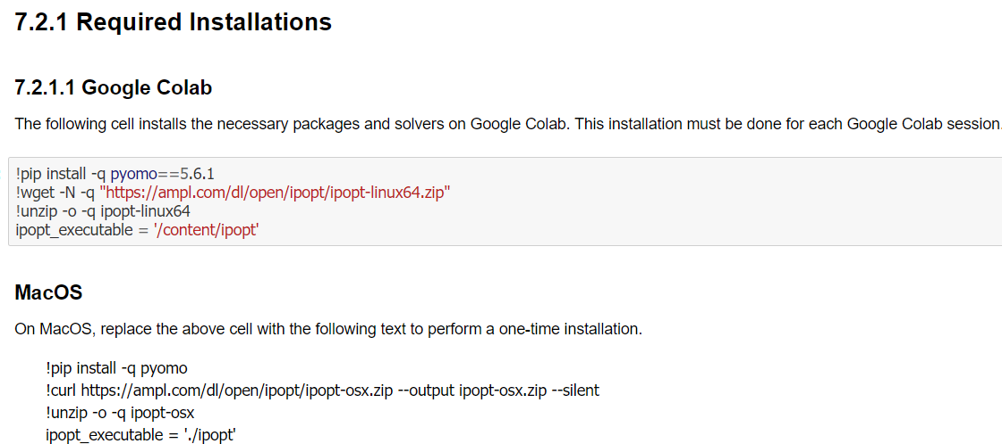
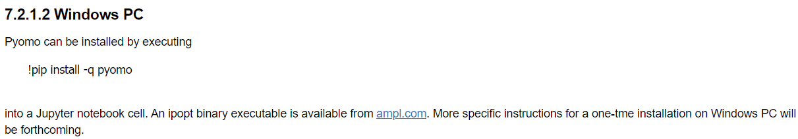
Simulation and Optimal Control: Soft Landing a Rocket

Slide 13
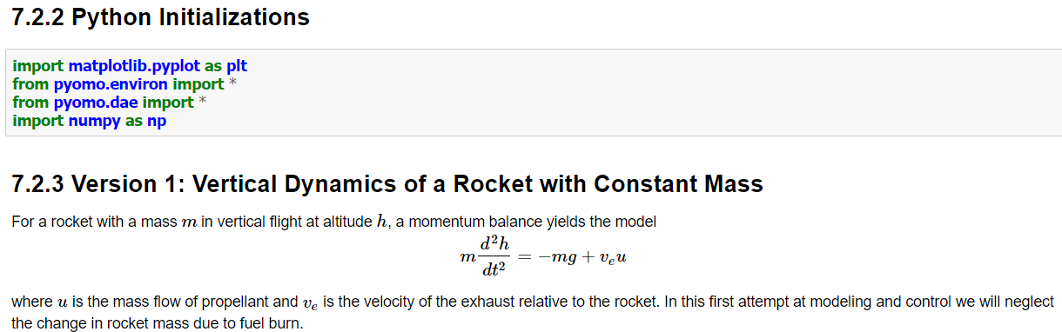
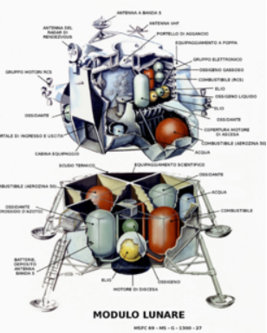
Simulation and Optimal Control: Soft Landing a Rocket

Slide 14
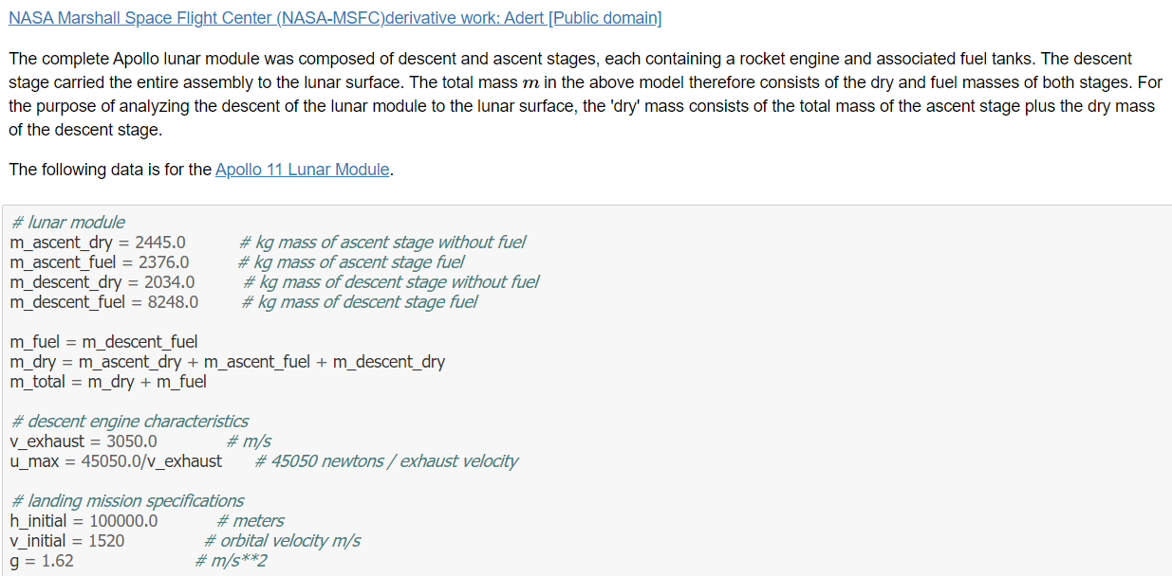
Simulation and Optimal Control: Soft Landing a Rocket

Slide 15
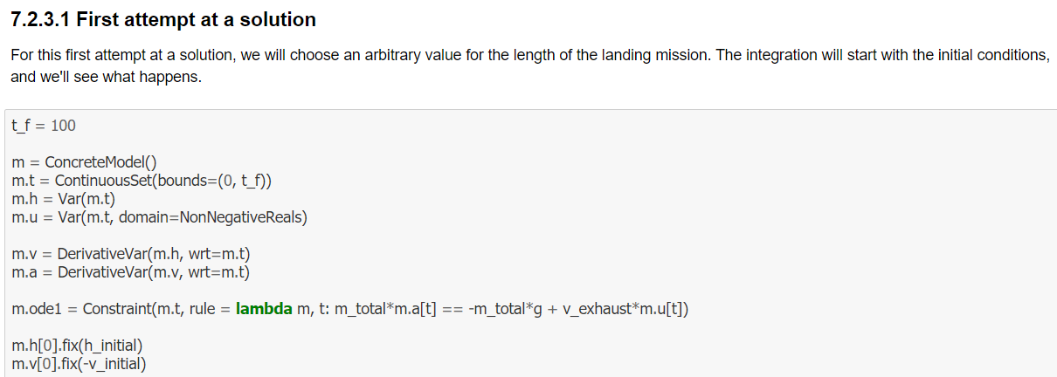
Simulation and Optimal Control: Soft Landing a Rocket

Slide 16
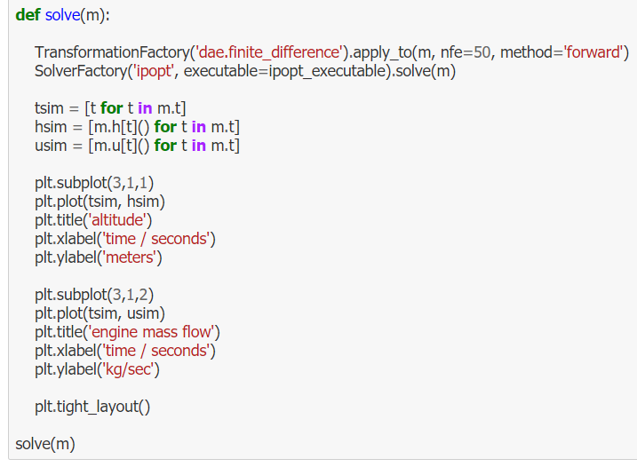
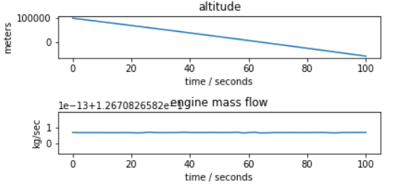
Simulation and Optimal Control: Soft Landing a Rocket

Slide 17
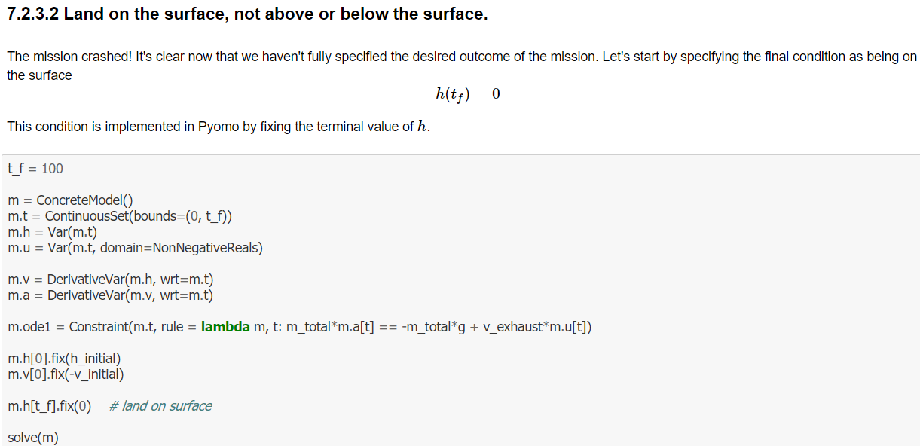
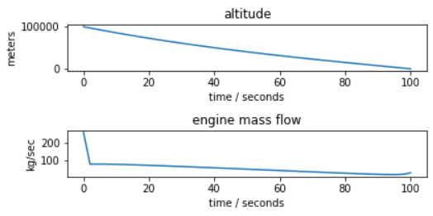
Simulation and Optimal Control: Soft Landing a Rocket

Slide 18
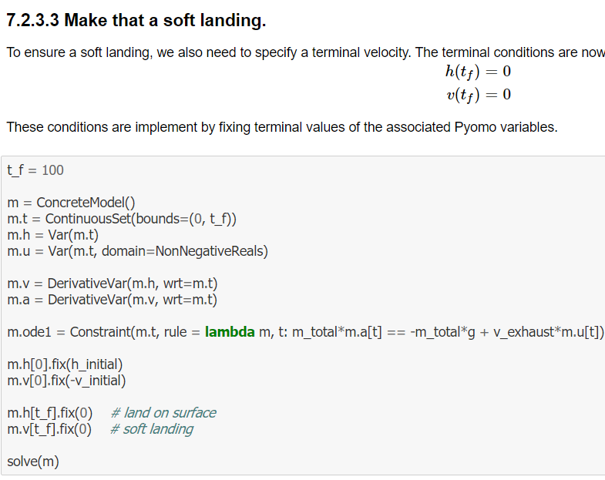
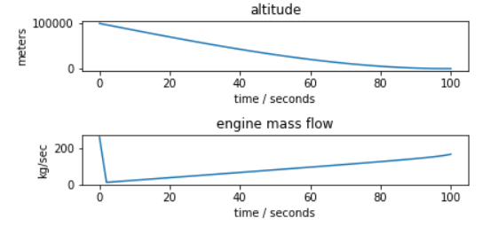
Simulation and Optimal Control: Soft Landing a Rocket

Slide 19
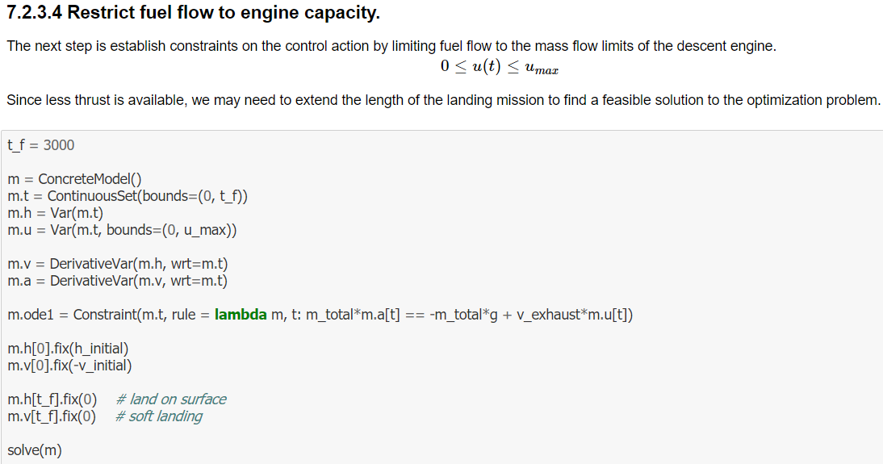
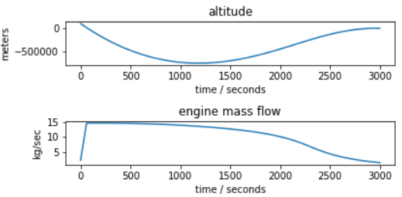
Simulation and Optimal Control: Soft Landing a Rocket

Slide 20
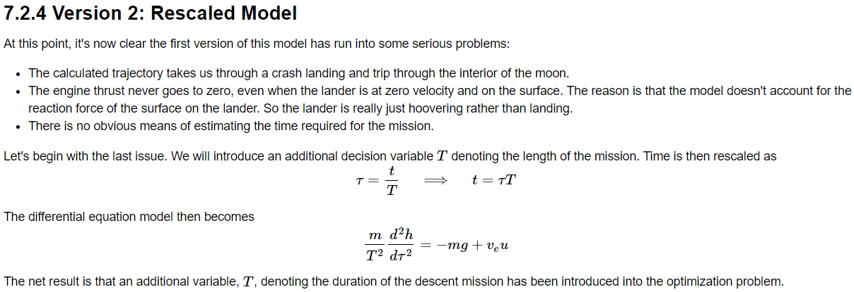
Simulation and Optimal Control: Soft Landing a Rocket

Slide 21
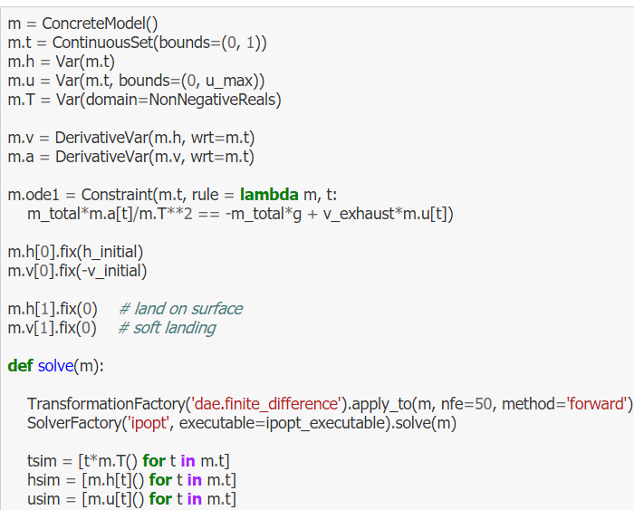
Simulation and Optimal Control: Soft Landing a Rocket

Slide 22
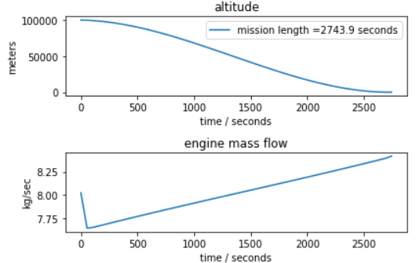
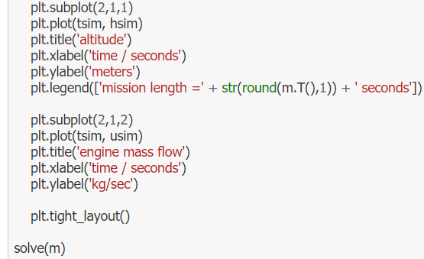
Simulation and Optimal Control: Soft Landing a Rocket

Slide 23
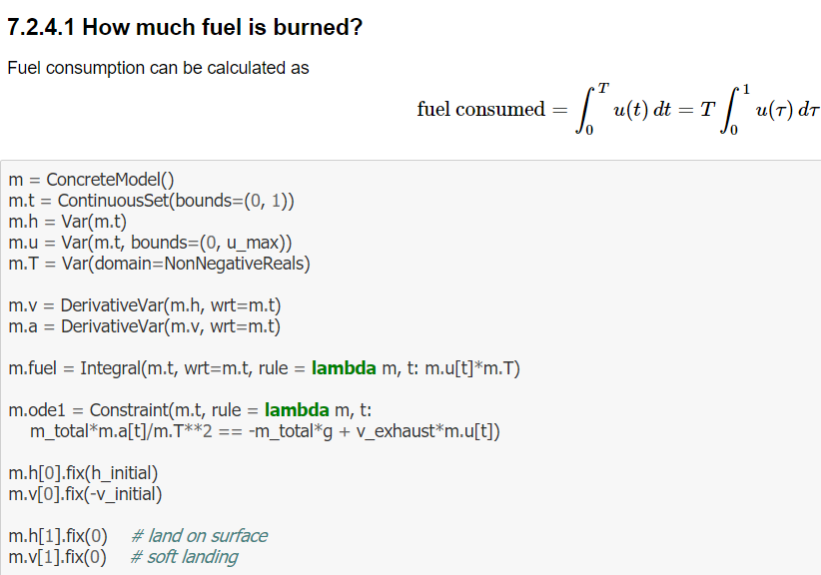
Simulation and Optimal Control: Soft Landing a Rocket

Slide 24
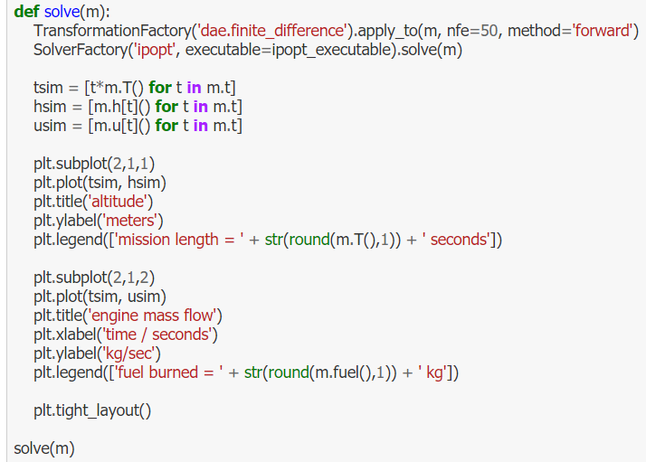
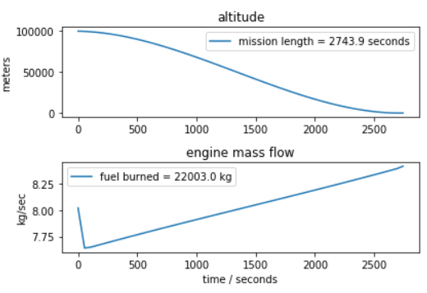
Simulation and Optimal Control: Soft Landing a Rocket

Slide 25
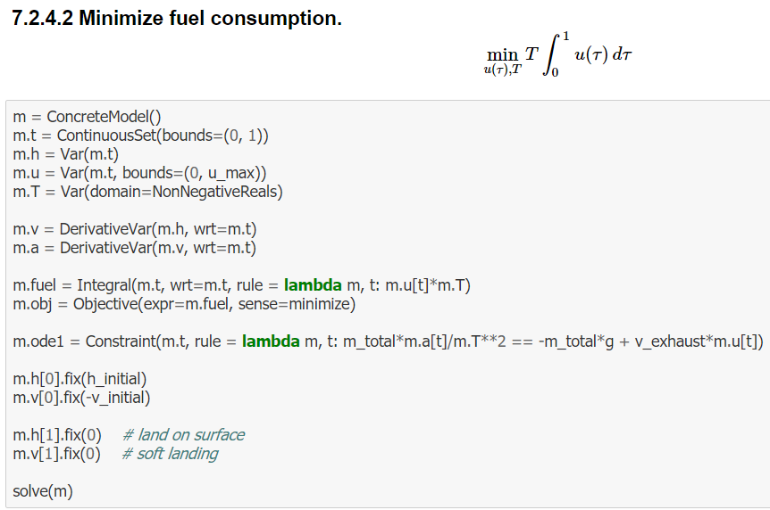
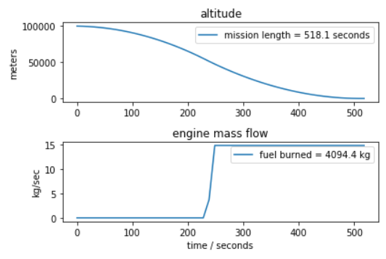
Simulation and Optimal Control: Soft Landing a Rocket

Slide 26
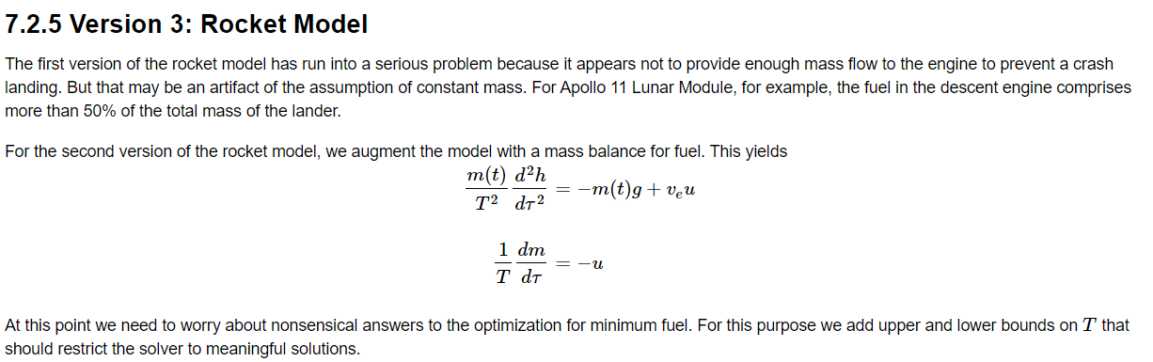
Simulation and Optimal Control: Soft Landing a Rocket

Slide 27
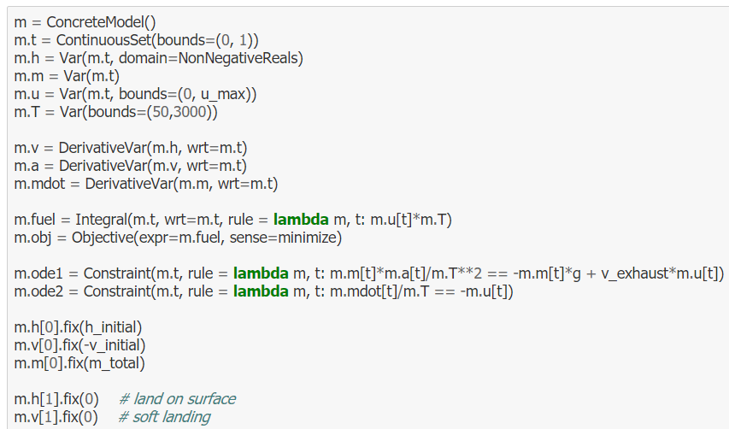
Simulation and Optimal Control: Soft Landing a Rocket

Slide 28
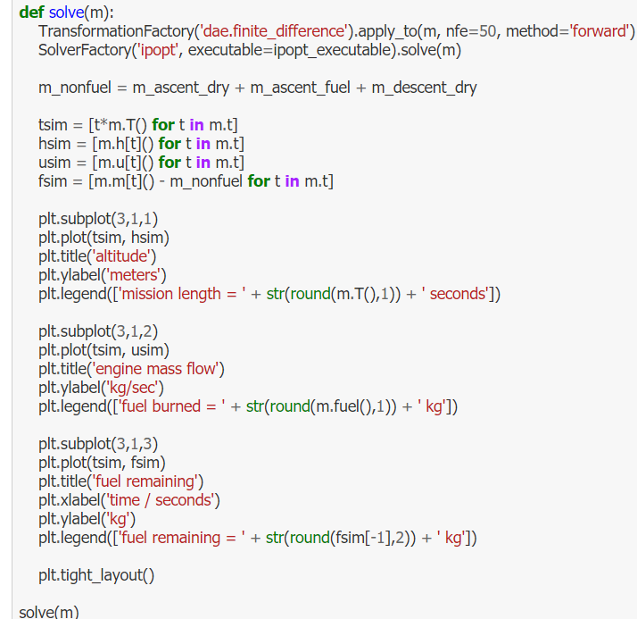
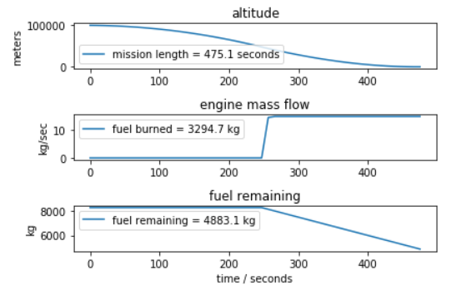
Simulation and Optimal Control: Soft Landing a Rocket

